Slide 1
Sentiment Analysis:
By: Muhammad Javed

Slide 2




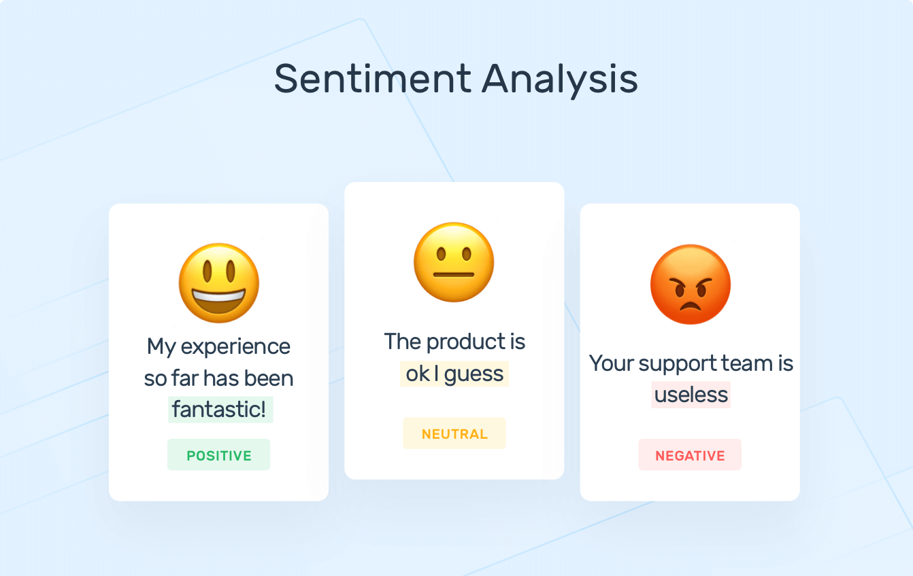
www.tuf.edu.pk
unioffaisalabad

Slide 3

Sentiment Analysis
www.tuf.edu.pk
unioffaisalabad
Defintion
Process of Sentiment Analysis
Example
Why perform Sentiment Analysis?
Types of Sentiment Analysis
How does Sentiment Analysis work?
Applications
Challenges of Sentiment Analysis
Use Cases for Sentiment Analysis
Examples of Sentiment Analysis
Conclusion

Slide 4

www.tuf.edu.pk
unioffaisalabad
Definition:
Sentiment analysis is a popular task in natural language processing. The goal of sentiment analysis is to classify the text based on the mood or mentality expressed in the text, which can be positive negative, or neutral.
Sentiment analysis is the process of analyzing digital text to determine if the emotional tone of the message is positive, negative, or neutral.

Slide 5
www.tuf.edu.pk
unioffaisalabad
Process of Sentiment Analysis:
Sentiment analysis is the process of classifying whether a block of text is positive, negative, or, neutral. The goal which Sentiment analysis tries to gain is to be analyzed people’s opinions in a way that can help businesses expand. It focuses not only on polarity (positive, negative & neutral) but also on emotions (happy, sad, angry, etc.). It uses various Natural Language Processing algorithms such as Rule-based, Automatic, and Hybrid.

Slide 6
www.tuf.edu.pk
unioffaisalabad
Example
If we want to analyze whether a product is satisfying customer requirements, or is there a need for this product in the market? We can use sentiment analysis to monitor that product’s reviews. Sentiment analysis is also efficient to use when there is a large set of unstructured data, and we want to classify that data by automatically tagging it.Net Promoter Score (NPS) surveys are used extensively to gain knowledge of how a customer perceives a product or service. Sentiment analysis also gained popularity due to its feature to process large volumes of NPS responses and obtain consistent results quickly.

Slide 7
www.tuf.edu.pk
unioffaisalabad
Net Promoter Score:
Net Promoter Score® (NPS) is a measure used to gauge customer loyalty, satisfaction, and enthusiasm with a company, calculated by asking customers one question: “On a scale from 0 to 10, how likely are you to recommend this product/company to a friend or colleague?” Aggregate NPS scores help businesses improve upon service, customer support, delivery, etc. for increased customer loyalty.

Slide 8
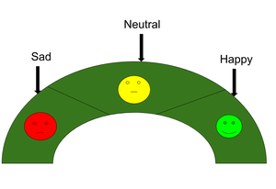
www.tuf.edu.pk
unioffaisalabad

Slide 9
Why perform Sentiment Analysis?
www.tuf.edu.pk
unioffaisalabad
Sentiment analysis is the contextual meaning of words that indicates the social sentiment of a brand and also helps the business to determine whether the product they are manufacturing is going to make a demand in the market or not.
According to the survey,80% of the world’s data is unstructured. The data needs to be analyzed and be in a structured manner whether it is in the form of emails, texts, documents, articles, and many more.
Sentiment Analysis is required as it stores data in an efficient, cost-friendly.
(2) Sentiment analysis solves real-time issues and can help you solve all real-time scenarios.

Slide 10
Types
www.tuf.edu.pk
unioffaisalabad
There are Four types of Sentiment Analysis
Fine-grained sentiment analysis
Emotion Detection
Aspect-based sentiment analysis
Multilingual sentiment analysis

Slide 11
Types
www.tuf.edu.pk
unioffaisalabad
Fine-grained sentiment analysis: This depends on the polarity base. This category can be designed as very positive, positive, neutral, negative, or very negative. The rating is done on a scale of 1 to 5. If the rating is 5 then it is very positive, 2 then negative, and 3 then neutral.
Emotion detection: The sentiments happy, sad, angry, upset, jolly, pleasant, and so on come under emotion detection. It is also known as a lexicon method of sentiment analysis.
Aspect-based sentiment analysis: It focuses on a particular aspect for instance if a person wants to check the feature of the cell phone then it checks the aspect such as the battery, screen, and camera quality then aspect based is used.
Multilingual sentiment analysis: Multilingual consists of different languages where the classification needs to be done as positive, negative, and neutral. This is highly challenging and comparatively difficult.

Slide 12
How does Sentiment Analysis work?
www.tuf.edu.pk
unioffaisalabad
There are four approaches used:
Rule-based approach
Machine Learning approach
Neural network approach
Hybird approach

Slide 13
How does Sentiment Analysis work?
www.tuf.edu.pk
unioffaisalabad
(1) Rule-based approach: Over here, the lexicon method, tokenization, and parsing come in the rule-based. The approach is that counts the number of positive and negative words in the given dataset. If the number of positive words is greater than the number of negative words then the sentiment is positive else vice-versa.
(2) Machine Learning Approach: This approach works on the machine learning technique. Firstly, the datasets are trained and predictive analysis is done. The next process is the extraction of words from the text is done. This text extraction can be done using different techniques such as Naive Bayes, Support Vector machines, hidden Markov model, and conditional random fields like this machine learning techniques are used.
(3) Neural network Approach: In the last few years neural networks have evolved at a very rate. It involves using artificial neural networks, which are inspired by the structure of the human brain, to classify text into positive, negative, or neutral sentiments. it has Recurrent neural networks, Long short-term memory, Gated recurrent unit, etc to process sequential data like text.
(4) Hybrid Approach: It is the combination of two or more approaches i.e. rule-based and Machine Learning approaches. The surplus is that the accuracy is high compared to the other two approaches.

Slide 14
Applications of Sentiment Analysis
www.tuf.edu.pk
unioffaisalabad
Sentiment Analysis has a wide range of applications as:
Social Media
Customer Services
Marketing Sector
Reviewer Side

Slide 15
Applications of Sentiment Analysis
www.tuf.edu.pk
unioffaisalabad
Social Media: If for instance the comments on social media side as Instagram, over here all the reviews are analyzed and categorized as positive, negative, and neutral.
(2) Customer Service: In the play store, all the comments in the form of 1 to 5 are done with the help of sentiment analysis approaches.
(3) Marketing Sector: In the marketing area where a particular product needs to be reviewed as good or bad.
(4) Reviewer side: All the reviewers will have a look at the comments and will check and give the overall review of the product.

Slide 16
Challenges of Sentiment Analysis
www.tuf.edu.pk
unioffaisalabad
There are major challenges in the sentiment analysis approach:
If the data is in the form of a tone, then it becomes really difficult to detect whether the comment is pessimist or optimistic.
If the data is in the form of emoji, then you need to detect whether it is good or bad.
Even the ironic, sarcastic, comparing comments detection is really hard.
Comparing a neutral statement is a big task

Slide 17
Use Cases for Sentiment Analysis
www.tuf.edu.pk
unioffaisalabad
Some use cases for sentiment analysis are follow as:
Analyzing Customer Feedback
Campaign Monitoring
Brand Monitoring
Stock Market Analysis
Compliance Monitoring

Slide 18
Examples of Sentiment Analysis
www.tuf.edu.pk
unioffaisalabad
Some examples of sentiment analysis are as:
Sentiment Analysis of Hindi Text using python
Facebook Sentiment Analysis using python
Twitter Sentiment Analysis using python
Sentiment Analysis with Recurrent Neural Networks(RNN)
Emotion Detection using Bidirectional LSTM
Sentiment Classification using BERT

Slide 19
Conclusion
www.tuf.edu.pk
unioffaisalabad
Sentiment analysis is a powerful tool that you can use to solve problems from brand influence to market monitoring. New tools are built around sentiment analysis to help businesses become more efficient.

